Slide 1
L04: HTML Continued
CSCI 185, Spring 2023 Intro to Computer Programming for the Web

Slide 2
Announcements
Join the CSCI 185 Discord Server: https://discord.gg/hve8jp2J
HW1 due tonight
HW2 Posted. Due next Monday at midnight
Wednesday:
We’re setting up git and GitHub on your computer
Please bring your computer to class
This is an important day to be on time for
Tutorial 3 (Friday): Make a homepage to showcase your work in this class.

Slide 3
Learning Goals for Today
Understand why semantic tags are important
Understand how to specify relative links

Slide 4
Outline
Overview of some web concepts
Semantic Tags
Understanding Linking
Linking Activity

Slide 5
Outline
Overview of some web concepts
Semantic Tags
Understanding Linking
Linking Activity

Slide 6
Some questions about the web...
What’s the difference between the Internet and the Web?
Who invented the world wide web?
What is a URL?
What is HTTP?
What is a web server?
What is a browser?
What is an IP address?
What is a domain name?
What is a search engine?
What is a screen reader?

Slide 7
What’s the difference between the Internet and the Web?
The web is only one of many applications powered by the Internet. Other web applications include:
Email
Networked Television (such as cable)
Peer-to-peer file sharing
Telephony
Skype, Google Hangout, GoToMeeting
Many other networked applications (gaming engines, ITunes, etc.)

Slide 8
Who invented the Worldwide Web?
1989: Tim Berners-Lee, a British computer scientist, conceptualized and built the three foundational web technologies:
HTML: HyperText Markup Language. The markup (formatting) language for the web.
URI: Uniform Resource Identifier. A kind of “address” that is unique and used to identify to each resource on the web. It is also commonly called a URL.
HTTP: Hypertext Transfer Protocol. Allows for the retrieval of linked resources from across the web.
Source: https://webfoundation.org/about/vision/history-of-the-web/

Slide 9
What is a URL?
A URL, or Uniform Resource Locator, is a reference to a web resource that specifies its location on a computer network and a mechanism for retrieving it.
A typical URL could have the form: http://www.example.com/index.html:
http: the protocol (see next slide)
www.example.com: the hostname (domain name)
index.html: the file name to be retrieved

Slide 10
What is HTTP (Hypertext Transfer Protocol)?
Refers to the rules that servers and browsers must follow to in order to transfer web files over the Internet.
HTTP allows (authorized) users to create, update, or delete resources on a web server
HTTPS adds encryption and verification to the data transmission process

Slide 11

What is a web server?
A computer or device on a network that other computers can access for information, communication, or computational services
Any computer can become a web server if...
It has been given a public address (IP address)
It listens to requests over Port 80 (HTTP) or Port 443 (HTTPS)

Slide 12
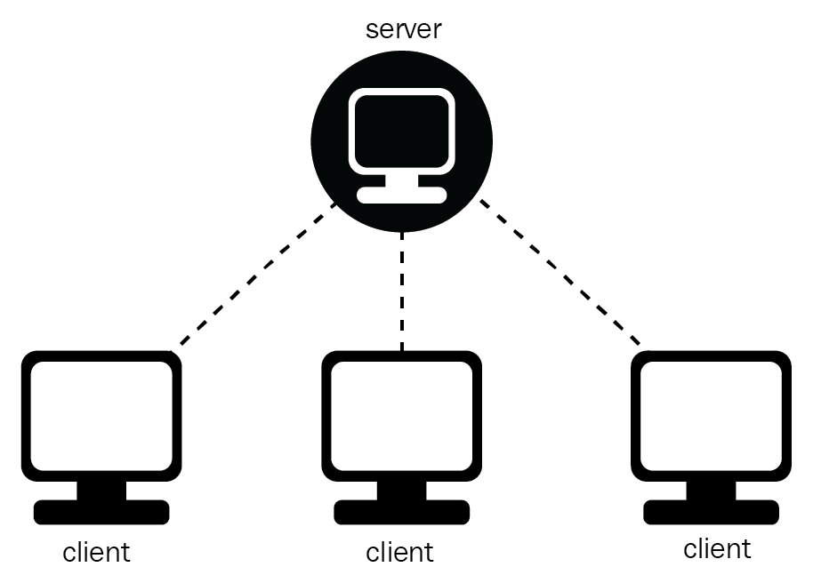
What is a web browser?
Web Server
A software program that allows a user to locate, access, and display Web pages. Examples of web browsers include:
Safari, Firefox, Chrome, Internet Explorer, and Opera
Browser
Browser
Browser

Slide 13
What is an IP address?
An IP address is network address for your computer so the Internet knows where to send you emails, data and pictures of cats
The IANA allocates IP address blocks to regional Internet registries (RIRs). Today, there are five RIRs – APNIC, ARIN, RIPE NCC, LACNIC and AFRINIC that are responsible for all continents. These are then divided into smaller sub-blocks and assigned to individuals and institutions
We have already run out of IP addresses (e.g. 66.171.248.170), and so we’re now in the process of transitioning to IPv6. A slow process of adoption.
Source: https://blog.ip2location.com/knowledge-base/study-of-ipv4-address-allocation-by-continents/

Slide 15
What is a domain name?
A way of assigning human-readable names to IP addresses (which are difficult to remember)
To “Purchase” a domain name (really you’re leasing it), you pay money to an authorized registrar (GoDaddy is the biggest one)
The domain name system (DNS) is a hierarchical naming system (big dictionary) that keeps track of IP addresses and their associated domain names
Makes it possible to assign domain names to groups of Internet resources and users, regardless of the entities' physical location

Slide 16
What is a search engine?
A system for organizing and retrieving Web pages. Search engines perform three basic tasks:
Crawling – where content is discovered
Indexing – where it is analysed and stored in huge databases; and
Retrieval – where a user query fetches a list of relevant pages and sorts them.

Slide 17
How do search engines work?
General process:
Visits a page and makes a copy of it; stores both the link and the contents of the webpage somewhere (i.e. in a database)
Extracts content from the various sections
uses some logic to build a list of keywords for each page, and some summary text to communicate what this page is about.
Reads all of the link URLs on that page, then visits those pages and makes copies of them (i.e., repeat step 1-2)
Uses the information from those links to rank pages according to specific keywords
https://www.bbc.com/bitesize/articles/ztbjq6f

Slide 18
Search Engines & PageRank
PageRank is a famous algorithm devised by Google
determines the relevance of a page according to popularity: The more links that point to a webpage, the more useful it will seem, and the higher it will appear in the results
Other important criteria:
How often the page is updated; more recent often more relevant (but not always); trustworthy domain; etc.
Search (and SEO) is big business
Why?
https://www.bbc.com/bitesize/articles/ztbjq6f

Slide 19
What is a Screen Reader?
A screen reader reads the HTML markup (or underlying code that controls a user interface) and “reads” the content aloud.
It is important to teach your screen reader what belongs together. For instance, by wrapping a section in a <nav></nav> tag, you can teach your screen reader that “this whole section is for the navigation.”
If your user doesn’t want the reader to read every link in the aloud, they can skip to the next section.
If you don’t thoughtfully use grouping tags, your user is stuck with a very annoying user experience.
Try it:
Mac: Command + F5
Windows: Windows Logo + Control + Enter

Slide 20
Outline
Overview of some web concepts
Semantic Tags
Understanding Linking
Linking Activity

Slide 21
Semantic Tags and Search Engines / Screen Readers
Semantic tags enable your web crawler / screen reader to understand your website: <h1>, <title>, <header>, <main>, <footer>, <article>, <aside>, etc.
Help the crawler / reader to “learn” the structure and organization of your site: <nav>, <ul>, <li>, <a>
This is not only easier for machines: good organization benefits everyone! People, other programmers, etc.
https://www.bbc.com/bitesize/articles/ztbjq6f

Slide 22
What are some examples of semantic tags?
Semantic tags were drafted in 2008, released as an official standard in 2014 via the HTML5 release
Before: all content was grouped / styled using the generic <div> tag
After: tags like <section>, <nav>, <article>, <aside>, <header>, <footer> and <main> make structuring content more clear / readable.
Helps search engines and screen readers interpret websites more easily
Demo on course website

Slide 23
A Semantic Web Vision
Tim Berners-Lee originally expressed his vision of the Semantic Web as follows:
“I have a dream for the Web [in which computers] become capable of analyzing all the data on the Web – the content, links, and transactions between people and computers. A "Semantic Web", which makes this possible, has yet to emerge, but when it does, the day-to-day mechanisms of trade, bureaucracy and our daily lives will be handled by machines talking to machines. The intelligent agents people have touted for ages will finally materialize.

Slide 24
Summary of the Vision
Web pages use “semantic” tags to section and annotate content
Web crawlers, scrapers, and machine readers target certain tags to extract key information and target / index this content
Once this is possible...
The entire web can be much more easily searched, organized, curated, etc.
Apps and software can be built (i.e. screen readers, tools that re-render content on-the-fly, browser extensions, etc.).

Slide 25
Outline
Overview of some web concepts
Semantic Tags
Understanding Linking
Linking Activity

Slide 26
Linking to Resources
Many tags use the concept of linking, including:
CSS references:
<link href="???" />
JavaScript references:
<script src="???"></script>
Multimedia embedding:
<img src="???" />
<iframe src="???"></iframe>
Hyperlinks:
<a href="???"></a>

Slide 27
Linking to Resources
Absolute links
When the file isn’t on your computer, you have to specify the server name, and then the path to the file.
Example: https://i.pinimg.com/originals/ac/f4/9b/acf49bd0f42b441160a9363dce88b243.jpg
Relative links
When the file is on your computer, you specify the file path relative to your current file.
Example: ../images/my_puppy.jpg Go up one directory, then into the images directory, and then access the “my_puppy.jpg” image.
Today

Slide 28
Scenario:
You are editing gallery.html.
Add a hyperlink that points to contact.html
Answer:
Which folder is gallery.html in?
Which folder is contact.html in?
How do you teach your browser to go up one directory and then over to home?
../home/contact.html
my_website
├── files
│ └── gallery.html
├── home
│ ├── contact.html
│ ├── index.html
│ └── styles
│ ├── dark
│ │ └── new.css
│ └── my_style.css
├── images
│ ├── cat.jpg
│ └── dog.jpg
└── test.html

Slide 29
Scenario:
You are editing gallery.html.
Add an image that points to dog.jpg
Answer:
../images/dog.jpg
my_website
├── files
│ └── gallery.html
├── home
│ ├── contact.html
│ ├── index.html
│ └── styles
│ ├── dark
│ │ └── new.css
│ └── my_style.css
├── images
│ ├── cat.jpg
│ └── dog.jpg
└── test.html

Slide 30
Scenario:
You are editing index.html.
Add a hyperlink link that points to test.html
Answer:
../test.html
my_website
├── files
│ └── gallery.html
├── home
│ ├── contact.html
│ ├── index.html
│ └── styles
│ ├── dark
│ │ └── new.css
│ └── my_style.css
├── images
│ ├── cat.jpg
│ └── dog.jpg
└── test.html

Slide 31
Scenario:
You are editing test.html.
Add a stylesheet link that points to new.css
Answer:
home/styles/dark/new.css
my_website
├── files
│ └── gallery.html
├── home
│ ├── contact.html
│ ├── index.html
│ └── styles
│ ├── dark
│ │ └── new.css
│ └── my_style.css
├── images
│ ├── cat.jpg
│ └── dog.jpg
└── test.html

Slide 32
Scenario:
You are editing test.html.
Add a hyperlink that points to gallery.html
Answer:
files/gallery.html
my_website
├── files
│ └── gallery.html
├── home
│ ├── contact.html
│ ├── index.html
│ └── styles
│ ├── dark
│ │ └── new.css
│ └── my_style.css
├── images
│ ├── cat.jpg
│ └── dog.jpg
└── test.html

Slide 33
Outline
Overview of some web concepts
Semantic Tags
Understanding Linking
Linking Activity

Slide 34
Linking Activity
Time to practice by following these instructions
Work in pairs (Sarah will assign you)
Help each other get to the end
Homework 2 is largely based on this activity!
When you’re done, your website should look like this.

